Slide 1

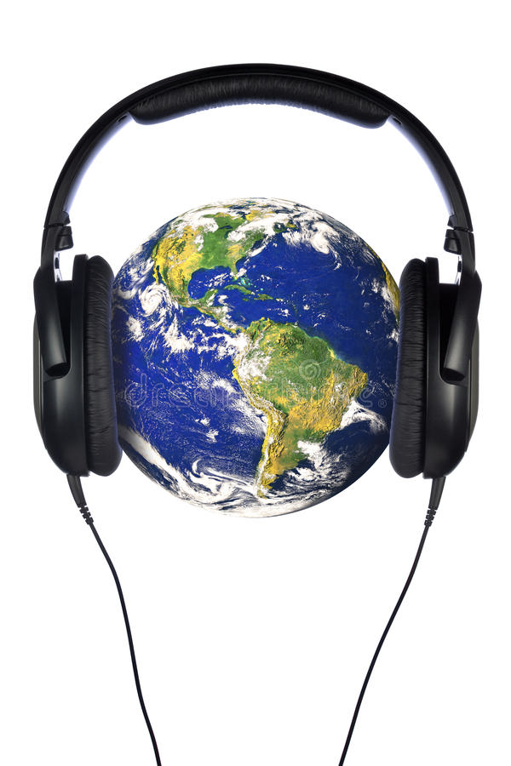
Music is a language
Music is a universal language, understood all over the world. Studies have shown that people from widely different backgrounds and cultures can listen to the same music and identify the same emotions from it.
The listening skills used in playing music are very similar to the listening skills needed to learn a new language. Learning to read and write music gives you the opportunity to communicate your ideas or emotions in a different way.

Slide 2
Music is maths
Music is divided into different fractions of time. Rhythms have to add up to the right number of beats per bar and musicians have to count those beats to make sure they play in the right place.
The brain processes mathematical and musical patterns in the same way, looking for repetition and symmetry.
Many great works of music have been shown to be structured according to the ‘Golden Ratio’, which is formed from the Fibonacci sequence.

Slide 3
Music is physical
Singing or playing an instrument requires great control over many muscles in your body. A singer or wind player must be able to control their breathing with their diaphragm. Instrumentalists need to control their fingers, and require excellent muscle memory in order to remember how to play each note. All of this physical control must be quick to react to any change in the music we are playing.
Many sports people use music to help them train or get into the right frame of mind before competing. Songs at the right speed can help you get into a rhythm when training, and even improve endurance.

Slide 4
Music is science
Music is the measure of time through sound. It can be broken down into exact scientific measurements: pitch is measured as the frequency of the sound waves, dynamics as volume in decibels, tempo as beats per minute.
Listening to music alters the chemicals in our brains. Playing music is one of the only activities that uses the whole brain at once, making connections between the visual, auditory, and motor cortices.

Slide 5
Music is history
Music has played a huge part in nearly every human culture throughout history. The oldest musical instruments discovered are a pair of flutes made be cavemen over 42,000 years ago. Musical styles and instruments have changed according to the fashion and technology of the times, from prehistoric flutes, to violins, to electric guitars and the computer generated sounds of today. Many historical figures, including Henry VIII, Gandhi and Einstein were accomplished musicians.

Slide 6
Art is a way of expressing thoughts, feelings, and ideas without the need for words. It needs imagination and creativity. Drawings and paintings are art to be looked at, whereas music is art to be listened to.

Slide 7
DIVERSITY IN
MUSIC

Slide 8
WOMEN
COMPOSERS

