Slide 1
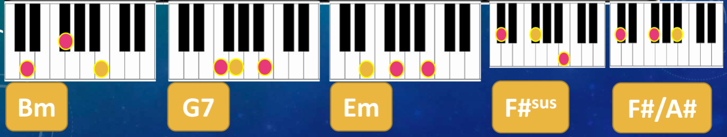
Musical knowledge 6: Hamilton
Definitions and theory
‘m’ = minor (no ‘m’ = major)
7 = added note a 7th above root
sus = suspended note
F# chord with A# in the bass: say ‘F# over A#’
Texture = how many thing are going on at once
Articulation = how the notes/chords are played
Sustained chords = each chord played once, held
Repeated chords = each chord played multiple times
Stab chords = single, short, accented chords followed by a rest
Inversion = when the chord notes are shuffled
Internal rhyme = when rhymes come during lines (not just at the end of lines)
Harmonic rhythm = how often chords change (i.e. once or twice per bar)

