Slide 1
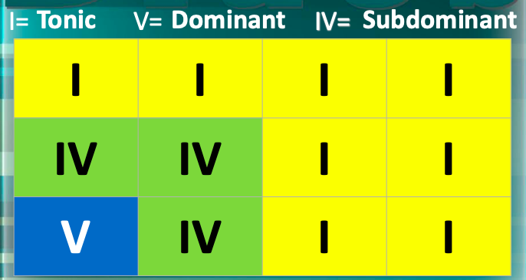
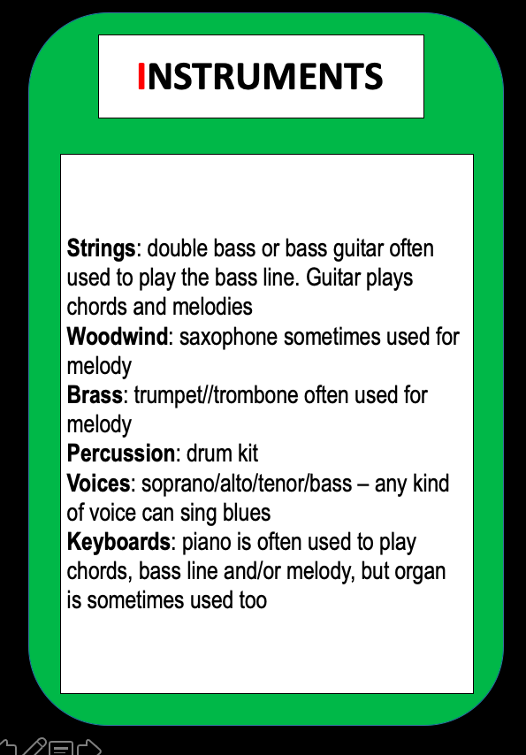
Musical knowledge 5: blues
Chords and Roman numerals
Definitions and theory
Whatever key you are in, count that as ’1’ (i.e. in C major, 1 is C)
From there, count up to 4 and 5 to work out what chords are IV and V (in C, IV is F and V is G)
Instruments for blues
12 bar blues = music based around this chord progression
Tonic = chord I
Subdominant = chord IV
Dominant = chord V
Improvisation = making it up on the spot
Turnaround = where you substitute chord V in bar 12
Seventh chord = when an extra note is added to a chord, 7 notes above the root, i.e. G7:

