Slide 1
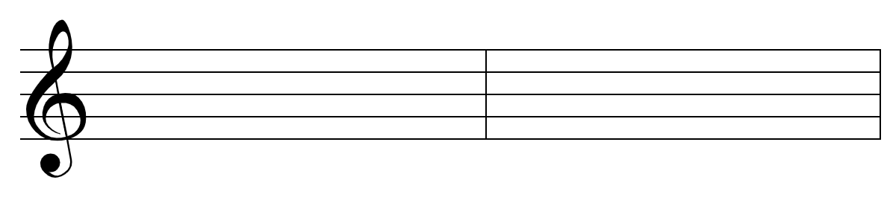
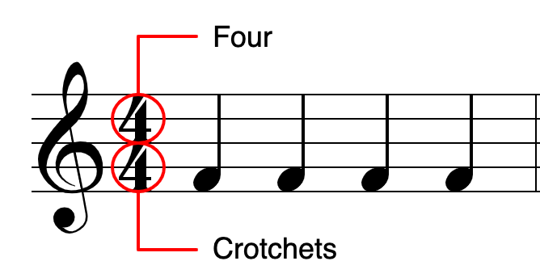
Musical knowledge 2: rhythm notation
How to read rhythms
These are the basic types of notes. American note names are more logical: here, the UK names are in brackets.
Chords can be major or minor
2. Rhythms can be made up of any combination of notes or rests, as long as each bar adds up correctly.
3. A dot after a note adds on half as much again:
4. A triplet squeezes three notes into the time it normally takes to play two:
Definitions
1. Pulse = the underlying count in the music. Like a heartbeat. You clap/dance to this. You feel it rather than hear it.
2. Rhythm = long and short notes, and the gaps between them:
P
U
L
S
E
Bars and time signatures
Pairs or 4s of quavers are beamed together. Remember each blob is a note.
Notes on the stave are divided up into bars by bar lines.
bar
bar
stave
bar line
bar line
= 3 beats
= 1½ beats
2. The time signature = two numbers at the start of the music. It tells us how many beats are in a bar: how we count in the piece.
3. The top number tells us how many beats are in a bar. The bottom number tells us what sort of beats they are.

