Slide 1
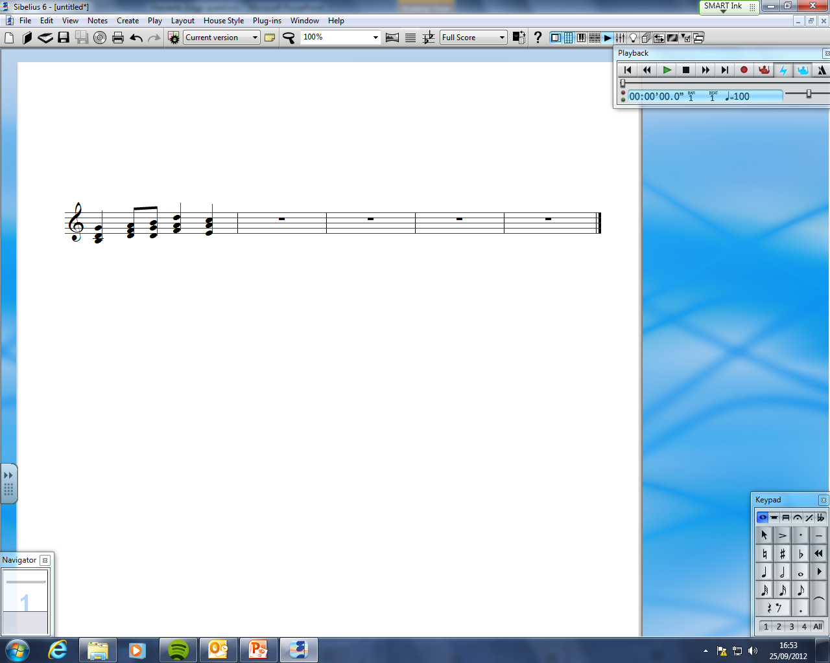
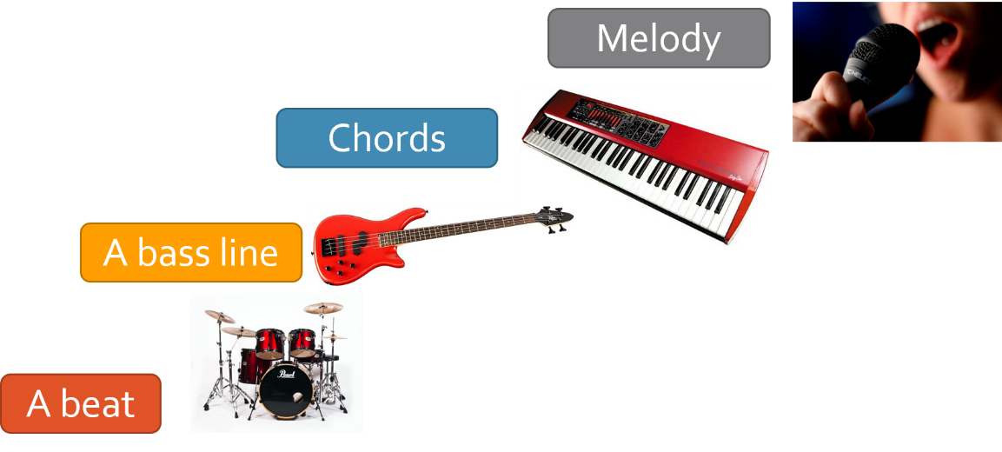
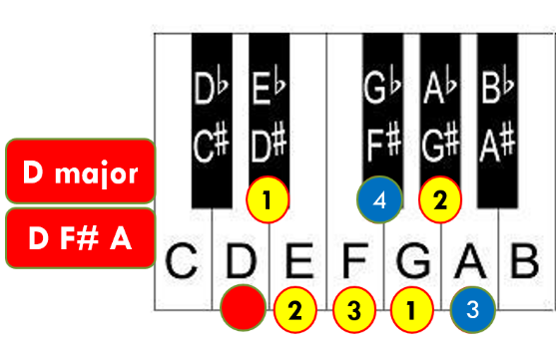
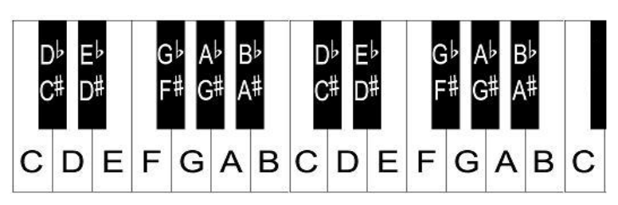
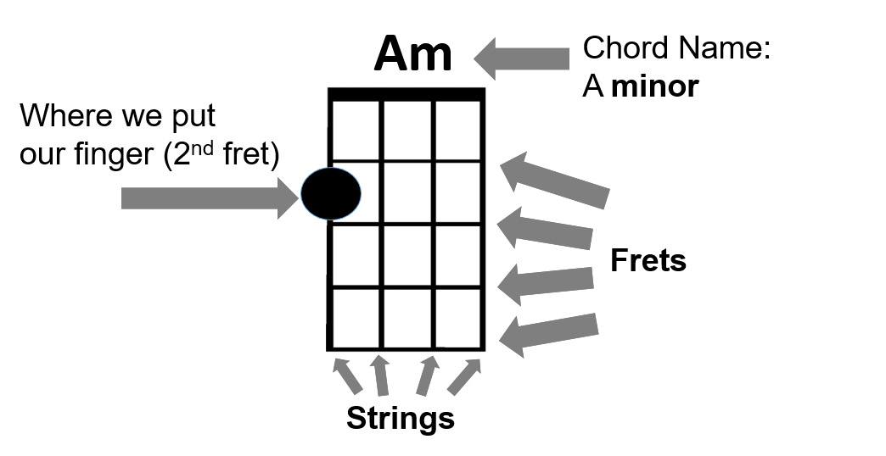
Musical knowledge 1: the essentials
Chords
Chord = 2+ notes played together
Chords can be major or minor
Chords are usually played on the keyboard, guitar, or ukulele.
Layers of sound
Melody = tune. One note at a time. Can be sung or played on an instrument.
1.
See opposite
2.
Bass line = the lowest part. One note at a time.
Major = 4 then 3 semitones. Sounds happy
Minor = 3 then 4 semitones. Sounds sad
3.
Played on a low-pitched instrument such as bass guitar, cello, double bass, tuba.
4.
Beat = rhythm. Played on unpitched instruments such as drums.
Semitone = the next note, counting white AND black
The bottom note of the chord = the root. The root gives its name to the chord.
Notes on a keyboard
Notes are in alphabetical order, going up to G
Say: ‘C is to the left of the two black keys: C D E F G A B’
down up
A note by itself CANNOT be major or minor!
(if there is no ‘m’ in the chord name, it is major)
3. Every black note has two names: sharp # and flat b
4. Flat = lower than white note
5. Sharp = higher than white note
Left hand side of chord diagram = string nearest your chin

